Slide 1
Generic Programming
Forget what Garo taught you

Slide 2
What is Generic Programming?
Generic programming is a style of computer programming in which algorithms are written in terms of types to-be-specified-later that are then instantiated when needed for specific types provided as parameters.

Slide 3


Slide 4
Talk is cheap! Show me the code!
Everybody should have NodeJS and CMake installed on their machines
git clone https://github.com/hamez0r/ez-gen.git
cd ez-gen
npm install –g
cd ..
git clone https://github.com/hamez0r/GenericProgrammingSummerSchool.git
cd GenericProgrammingSummerSchool
ez-gen
Go to build_win32 and open .sln file

Slide 5
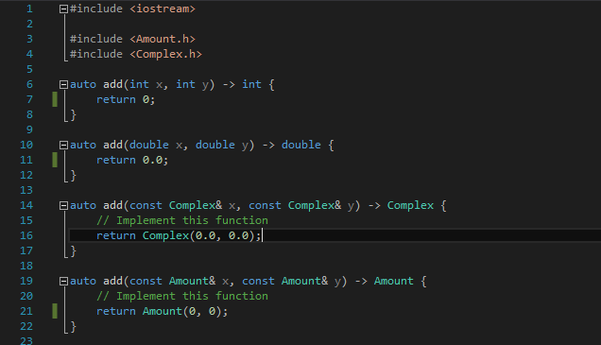
Functions

Slide 6

1.TemplateFunctions/main.cpp
Implement add(x, y) functions

Slide 7
There has to be an easier way!
What if we had other data structures we had to add ?

Slide 8

Welcome to template<typename T> functions

Slide 9
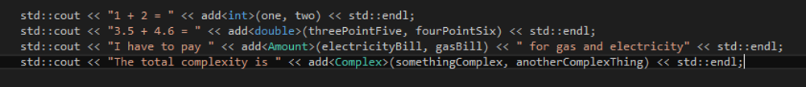
Does it compile?

Slide 10
Implicit interfaces
The data must implement the methods called by the template function

Slide 11
DataStructures/Amount.*
DataStructures/Complex.*
auto operator+(const Amount& other) const -> Amount;
auto operator+(const Complex& other) const -> Complex;

Slide 12
Classes
Let's implement a List of Amounts

Slide 13
2.TemplateClasses/main.cpp
class AmountList { };

Slide 14
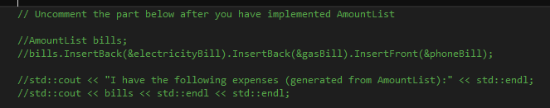
Let's see how it works

Slide 15
Implementing a List of Complex
Imagine the amount of Ctrl+P Ctrl+V, Find and Replace...
We're programmers, dammit! Not just scribes

Slide 16
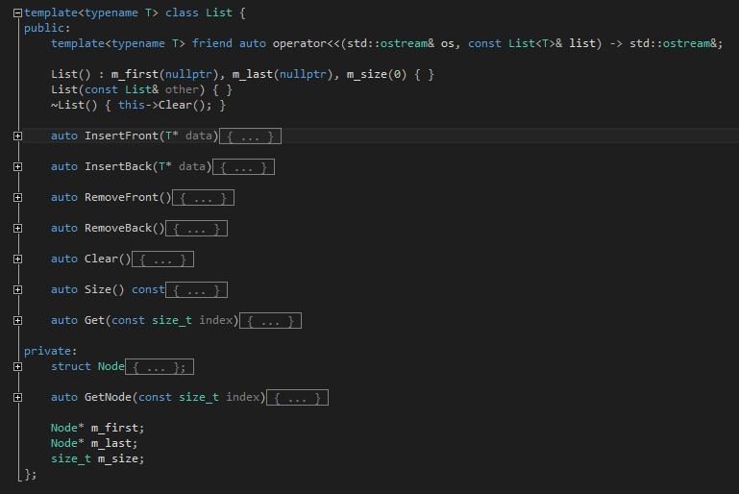
Welcome to template<typename T> classes

Slide 17
2.TemplateClasses/main.cpp
template<typename T> class List { };

Slide 18
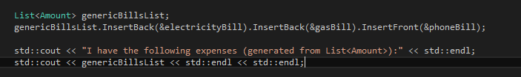

Slide 19

Let's check the standard library for a list!

Slide 20
Some things need to be handled differently...
Take a look at the classes defining some magnitudes in 3.TemplateSpecializations/main.cpp
We want to implement a Parameter class

Slide 21
3.TemplateSpecializations/main.cpp
template<typename T> class Parameter { };
template<> class Parameter<Dimensionless> { };

Slide 22
4.PolicyBasedDesign/main.cpp
Implement a Player class that can Attack() and Defend()
Use template classes and template specializations

Slide 23
Caveats
Define all implementations in header files
The compiler will generate the code from templates

Slide 24
Recap
What did we learn today?

Slide 25
Functions
Overloading is a good thing to do, but generic code is cleaner
However, be mindful of the implicit interfaces

Slide 26
Classes
Save development time – implement one generic data structure that can work for more scenarios
This can often lead to code reuse
Eliminate potential copy-pasta errors
No silver bullet – specialize classes when necessary
The compiler generates classes from the types you use to instantiate

Slide 27


Slide 28
Thank you!
https://bitbucket.org/hamez0r/genericprogrammingsolutions.git

